Slide 1


“Analytics on Career in STEM“
Team – Orange Dots .
Aditi Agrawal
Ankita Aggarwal
Priya Mishra

Slide 2
Analytics on STEM Careers
Team – Orange Dots .
Aditi Agrawal, Ankita Aggarwal, Priya Mishra

Slide 3

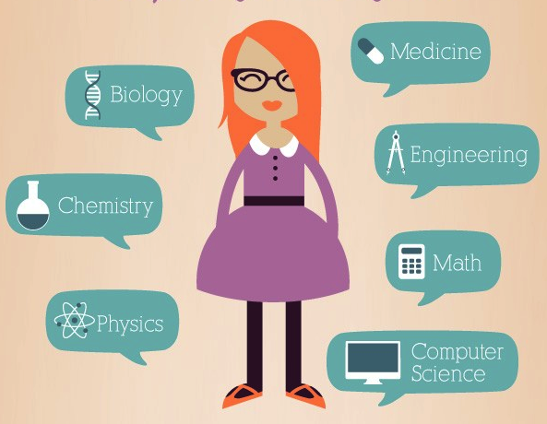

Notes:
What are you telling with your visualization? Past, Present, Future trends in STEM occupations and how it is a useful source of information for the aspiring minds to shape their future in right direction

Slide 4



Problem Statement

Slide 5


Notes:
Target Audience – High school students who aspire to build career in STEM but confused to choose the correct path.

Slide 6
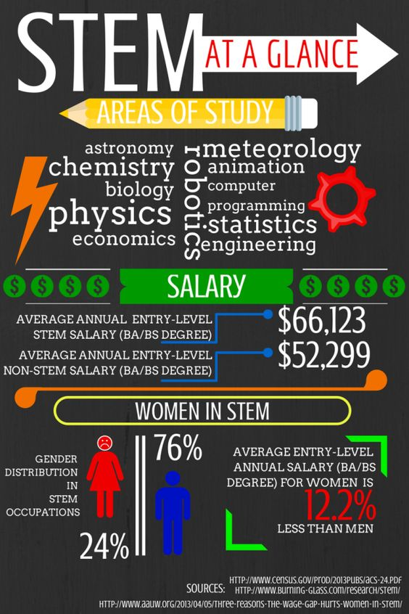


Slide 7
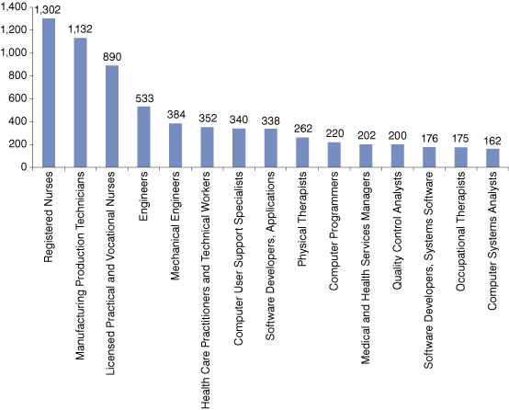
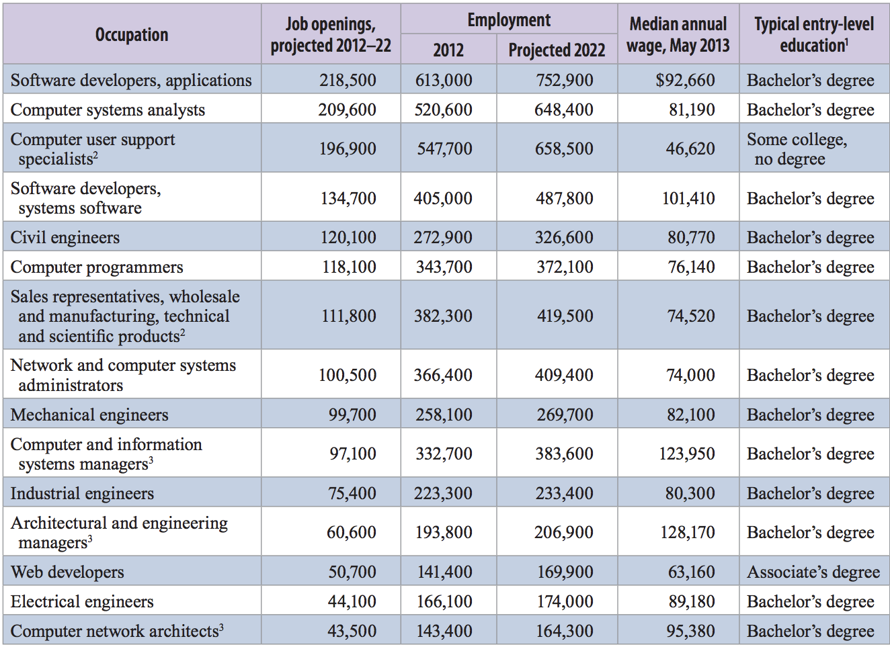
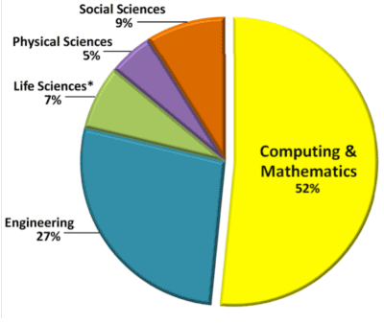
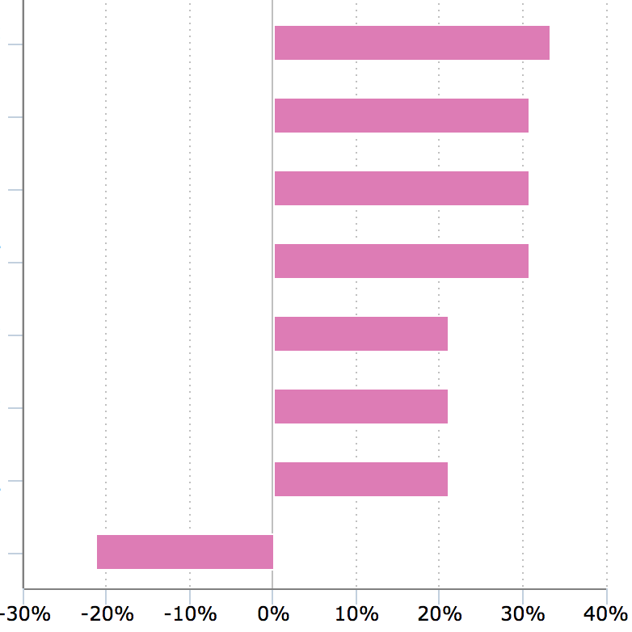
Notes:
Current STEM data is non interactive and uni-dimensional

Slide 8
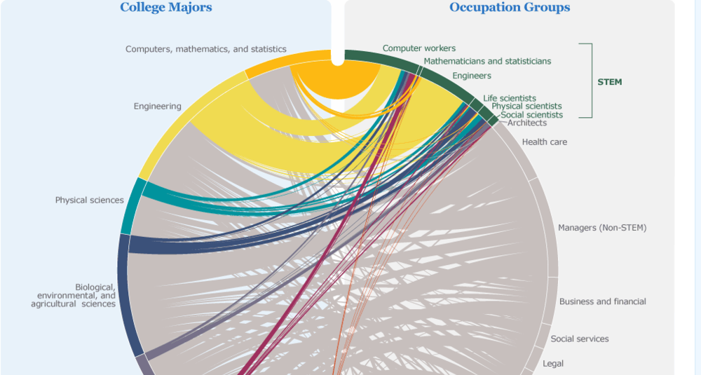
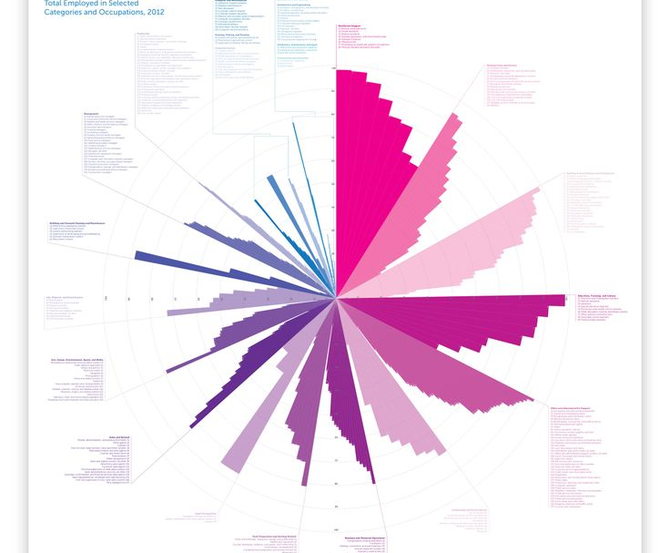

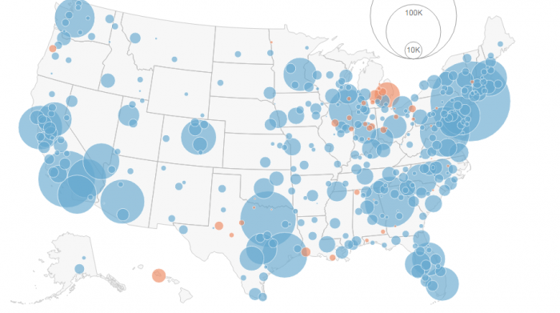
Notes:
We plan to make our Visualisations multi-dimensional, novel and easy to understand

Slide 9

Data Source
Notes:
Give our data about all existing occupations for the year 2012 – 2015. We apply our visualization techniques on a subset of this dataset

Slide 10

12. Technologies you plan to use

Slide 11
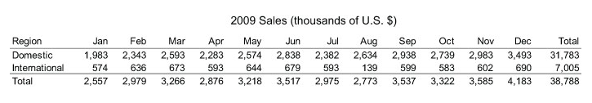
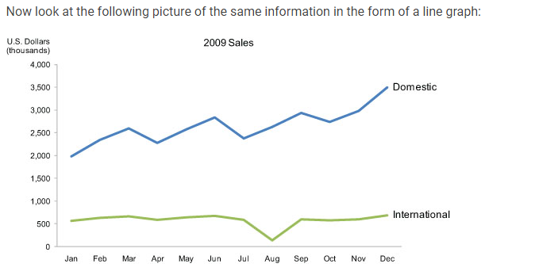
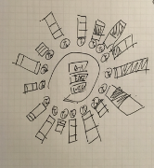
13. How to design, build and evaluate?
Design – A picture is worth a thousand words - but only when the story is best told graphically rather than verbally and the picture is well designed.
Notes:
Choosing the best design that represents the data will be the key design strategy.
Figure 13.1
This table does two things extremely well: it expresses these sales values precisely and it provides an efficient means to look up values for a particular region and month. But if we're looking for patterns, trends, or exceptions among these values, if we want a quick sense of the story contained in these numbers, or we need to compare whole sets of numbers rather than just two at a time, this table fails.
Figure 13.2
Several facts now leap into view:
Domestic sales were considerably and consistently higher than international.
Domestic sales trended upward over the year as a whole.
International sales, in contrast, remained relatively flat, with one glaring exception: they decreased sharply in August.
Domestic sales exhibited a cyclical pattern - up, up, down - that repeated itself on a quarterly basis, always reaching the peak in the last month of the quarter and then declining dramatically in the first month of the next.
What these numbers could not communicate when presented as text in a table, which our brains interpret through the use of verbal processing, becomes visible and understandable when communicated visually. This is the power of "data visualization."
https://www.interaction-design.org/literature/book/the-encyclopedia-of-human-computer-interaction-2nd-ed/data-visualization-for-human-perception

Slide 12
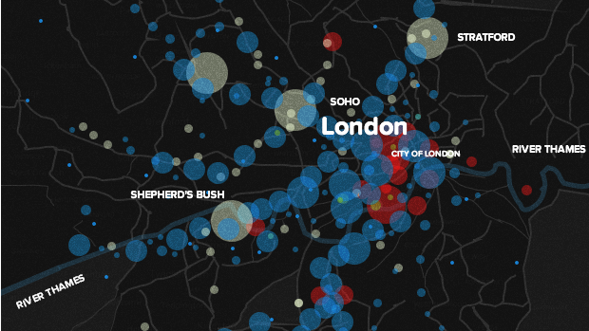
using D3 to build beautiful web maps
Notes:
Design goal : Create an experience which allows users to be able to play around and explore the employment statisitcs and dig out meaningful information that best suits their interest.

Slide 13
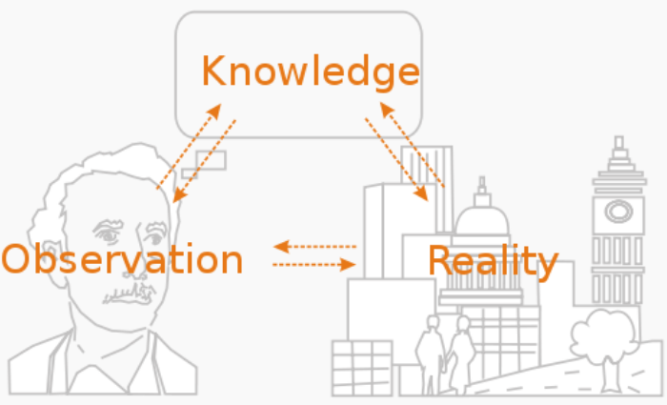
Evaluate
Notes:
Evaluation methodologies:
Observation
Focus Groups – evaluation team
Controlled experiments

Slide 14
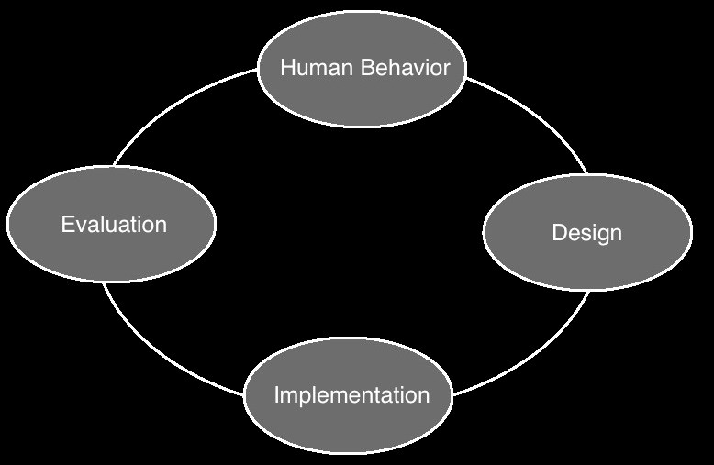

Slide 15
14. Deliverables?

Slide 16
a fully interactive visualization project covering multiple coordinated views representing different aspects of Occupational Employment Statistics.
a fully functional prototype demonstrating key features, and a process book documenting each steps as well.

Slide 17

15. How do you work together?

Slide 18
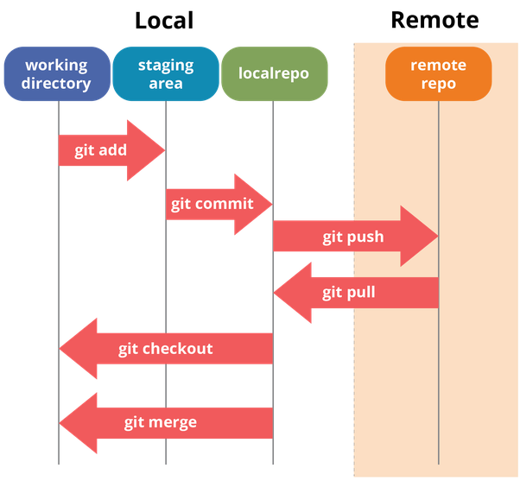


Slide 19

Timeline

Slide 20
Data collection
Comprehend data
Data cleaning to extract meaningful features
Pen and paper models
Complete prototype
D3 visualizations

